Slide 1

Analysis and Visualization of P&L data
Pushpa Devi
23/11/2024
This Photo by Unknown Author is licensed under CC BY-ND

Slide 2
Project Overview
Problem statement
Understanding the Data
Structuring and Populating the P&L Statement
Profitability Margin Calculations
Data Visualizations
Insights and Recommendations.

Slide 3
Problem Statement
ADIDAS wants to know its financial performance for last five years, I as a data analyst, need to prepare an Excel profit and loss(P&L) table for analysis. The table structure should include a revenue breakdown and essential P&L items leading to EBIT.
The analysis aims to provide insights into company’s performance from 2019 to 2023, focusing on revenue growth, profitability margins and the contribution of each business segments.

Slide 4
Data set Overview
The primary data source for this project was raw financial data extracted from Bloomberg.
The data set contains all relevant revenue and expense lines for past 5 years which can be utilized to construct P&L table and perform comprehensive analysis.

Slide 5
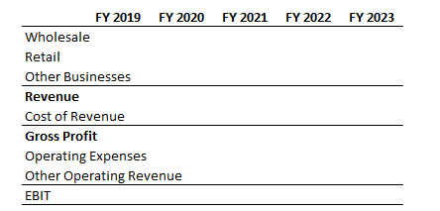
P&L structuring
I created a P&L structure using professional formatting that includes revenue break down and essential P&L items leading to EBIT
For clarity I renamed the ‘Operating income ‘ item to EBIT in my table

Slide 6
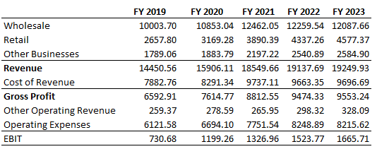
Data Extraction
Using INDEX and MATCH functions, I populated the P&L statement by extracting relevant data from the raw Bloomberg file.
I created Named Ranges in the source file to use in the formula.

Slide 7
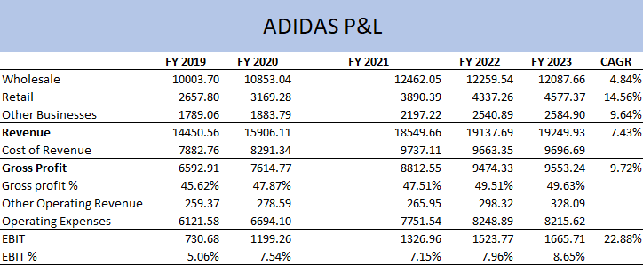
Profitability margin calculations
3
Gross Profit Margin: I calculated it by dividing Gross Profit by Revenue. It shows company’s operational efficiency.
EBIT Margin: I calculated it by dividing EBIT by Revenue. It indicates the company’s profitability by measuring its net income before interest and taxes
CAGR Calculation: Finally, I computed the Compound Annual Growth rate (CAGR) for Revenue, Gross Profit and EBIT using the following formula.
CAGR=((Final value/Beginning value)^(1/t)) - 1
1
2

Slide 8
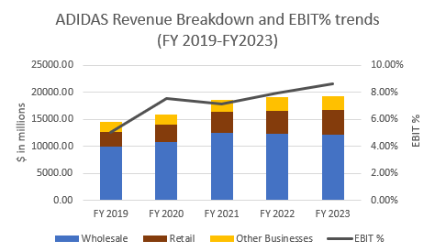
Data Visualization
I created a stacked column chart to provide a comprehensive view on how different business lines (Wholesale, Retail, Other Businesses) contributed to revenue and how the firm’s EBIT margin evolved.
I included EBIT% as a secondary axis for a clear understanding of this development.

Slide 9
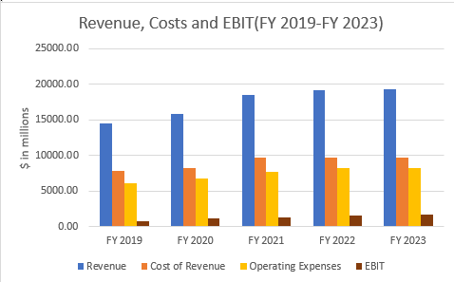
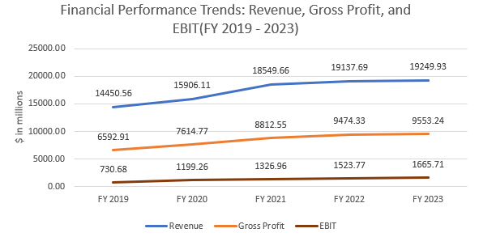
Data visualization
The stacked bar chart provides a detailed breakdown of Adidas' financial performance over the fiscal years FY 2019 to FY 2023, showing Revenue, Cost of Revenue, Operating Expenses, and EBIT.
The line chart shows the trends for Revenue, Gross Profit, and EBIT (Earnings Before Interest and Taxes) over the fiscal years FY 2019 to FY 2023

Slide 10
Data interpretation
How did the company’s performance measure up during this period?
Total revenue increased from $14,450 in FY 2019 to $19,249 in FY 2023.
Adidas had steady revenue growth across its major segments(Wholesale, Retail, Other businesses)
Were they able to accelerate revenue growth at a healthy rate?
Yes, Adidas was able to accelerate revenue growth at a healthy rate with 7.28% CAGR over the five-year period.

Slide 11
Data interpretation
Which business segment registered the fastest and slowest growth?
To determine the fastest and slowest growth rates among the business segments, we can use the Compound Annual Growth Rate (CAGR) column:
Retail has fastest growth rate with a CAGR of 14.56%.
Wholesale has slowest growth rate with a CAGR of 4.84%.
Was Adidas successful in maintaining its profitability while increasing revenue?
Yes, Adidas was successful in maintaining its profitability while increasing revenue.
Revenue increased from 14,450.56 (FY 2019) to 19,249.93 (FY 2023), which is a CAGR of 7.43%. EBIT increased from 730.68 in FY 2019 to 1,665.71 in FY 2023, reflecting a strong CAGR of 22.88%, much higher than the revenue CAGR.
The revenue growth and the significant growth in EBIT suggest enhanced operational efficiency and profitability over the analyzed period

Slide 12
Recommendations
As retail is the fastest growth segment with CAGR 14.56. Invest in expanding direct to consumer channels like e-commerce stores. Emphasize digital transformation and customer personalization to strengthen this growth trajectory.
The gross profit margin is stable and slightly improving (49.63% in FY 2023). Continue optimizing the supply chain to minimize costs while maintaining product quality.

Slide 13
The End

